Slide 1
COVID-19 DATA BETWEEN THE YEAR 2020 TO 2022

Slide 2
CONTENTS
Introduction
About the Data
Method of Analysis
Results
Conclusions

Slide 3
Introduction
Identifying the trend of Covid-19 cases between 2020-2022 in the world.

Slide 4
About the Data
The Dataset used contains the confirmed cases, the Death cases and the Recovery cases from different Countries from the year 2020 to 2022.
The raw dataset was gotten
from GitHub.

Slide 5
Methodology
The datasets were cleaned and merged together with the use of Power Query.
Analysis were carried out using Microsoft Excel.
Sorting and Calculations were done with the use of Pivot Tables.
Excel charts and Pivot charts were used to visualize the results.

Slide 6
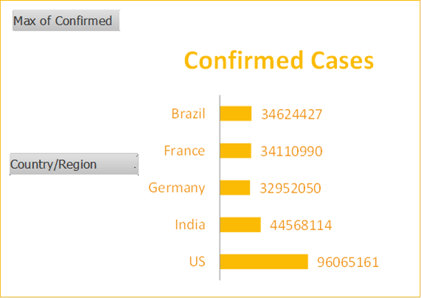
Confirmed Cases
US with a total of 96.1million has the highest cases, followed by India with a total of 44million.
The total number of confirmed cases as at the time the analysis were made is 602,796,643.

Slide 7
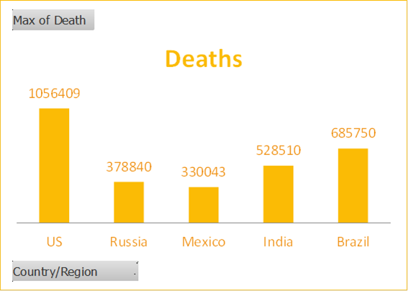
Death Cases
The top 5 countries with the highest death cases are United State, Russia, Mexico, India and Brazil.
The total number of Death cases was 6,487,401.

Slide 8
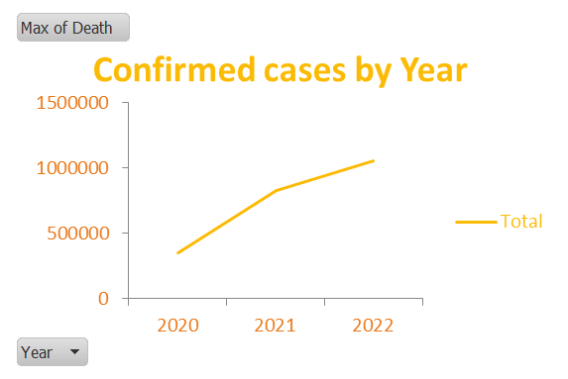
Confirmed Cases by Year
Confirmed cases increased by approximately 144% between 2020 and 2021 and had 55% increase between 2021 and 2022.
Confirmed cases continue
to increase every year.

Slide 9
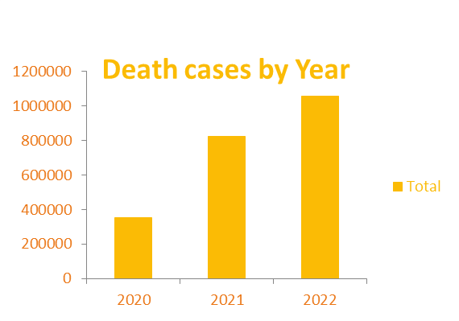
Death cases by Year
Death cases continue to increase every year.
Between 2020 and 2021, there was an increase in death by 87%.

Slide 10
Conclusions
With the analysis made, it is evident that people are still getting effected with Covid-19.
With the every year increment, people should take precautions by making use of Nose Masks, Hand Sanitizers and practising Social distance.
People should get vaccinated.

